Slide 1
Federated Learning
Presented To: Qurat-ul-Ain Raja

Slide 2
Presented BY
HAMMAD MUHAMMAD
RAMEEZ HASSAN RAJA
ABDUL MANNAN BHATTI
JAWAD AHMED
MUDASSIR MUKHTAR
MUHAMMAD USMAN

Slide 3
Overview
Introduction
What is Federated Learning
How Federated Learning Works
Classic Federated Learning Algrothim FED-AVG
Improvments of Fed Average
Frameworks and Data sets
Privacy Preserving

Slide 4
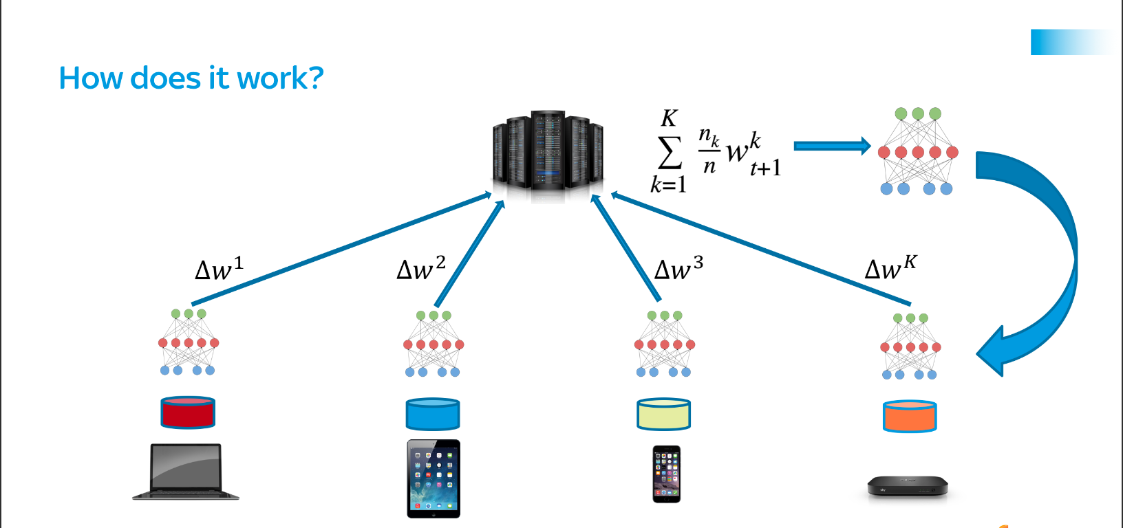
Introduction
Centralized model training involves gathering all data on a central server.
Centralization raises data privacy concerns, limiting access to sensitive data.
AI models shift towards decentralized approaches to address privacy challenges.
Emerges as a novel concept for decentralized machine learning.
Google pioneers federated learning, marking its initial usage.
Facebook (Meta) adopts and enhances federated learning.
Privacy-Preserving ML by keeping data on individual devices.
Only model updates are shared with a central server, ensuring data remains on individual devices.

Slide 5
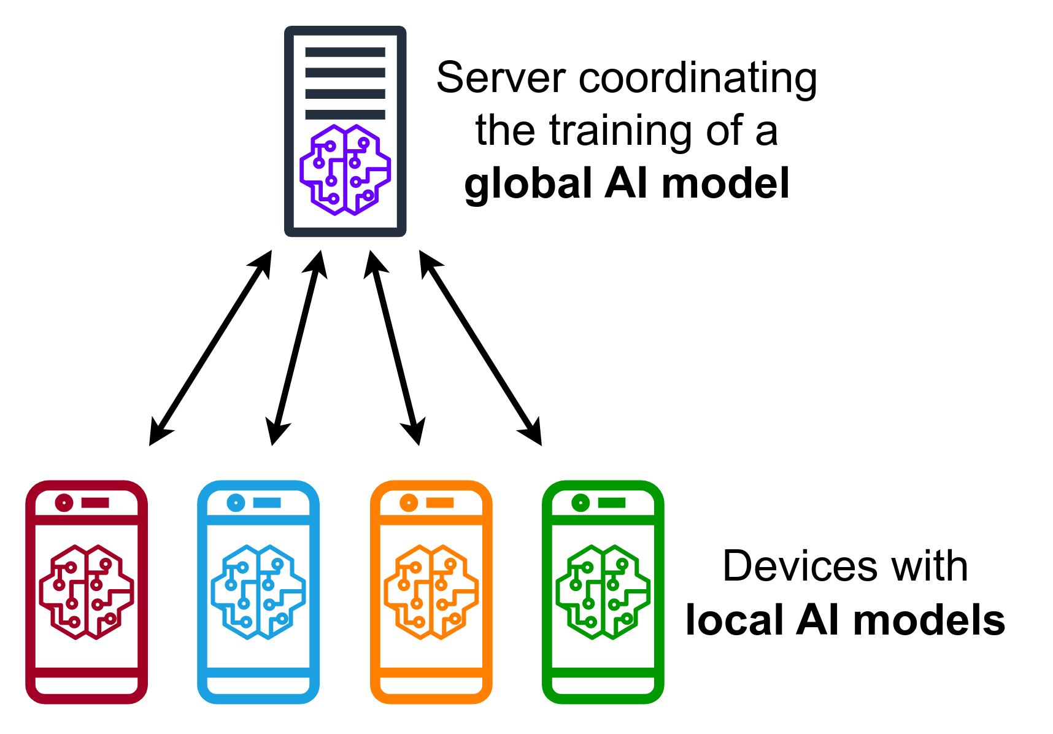
What is Federated Learning??
Federated learning (often referred to as collaborative learning) is a decentralized approach to training machine learning models. It doesn’t require an exchange of data from client devices to global servers. Instead, the raw data on edge devices is used to train the model locally, increasing data privacy. The final model is formed in a shared manner by aggregating the local updates.

Slide 6


How does federated learning works?
Model Initialization: A central server initializes a global model and sends it to participating devices.
Local Training: Each device trains the model on its own data, generating local updates.
Model Aggregation: The local updates are aggregated and averaged on the server, updating the global model.
Model Update: The updated global model is sent back to the devices for further training.

Slide 7
Why federated learning is important??
Data remains on the edge device, prioritizing user privacy.
Users have more control over their sensitive information.
Efficient model training at the edge.
Inherent security benefits with decentralized approach.
Enhances efficiency by distributing training across devices.
Facilitates collective model improvement without the need for centralizing sensitive information.

Slide 8
Difference between
Federated Learning
Machine Language
Decentralized data, each device or participant retains its own data locally, only model updates are shared.
Higher privacy, raw data never leaves devices.
Low communication costs, only model updates are sent.
High, can handle diverse data for more robust models.
Centralized data storage, all data is gathered and analyzed in one location.
Lower privacy due to centralized data storage.
High communication costs due to large data transmissions.
Limited, assumes similar data across participants.

Slide 9
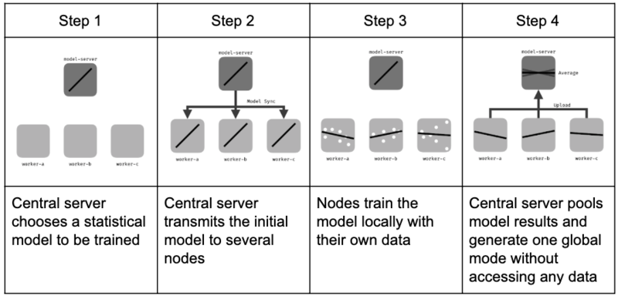
How does federated learning work??

Slide 10
FED-Average
The Federated Learning algorithm often referred to as "FED_Average" is a basic federated averaging approach commonly used in decentralized machine learning scenarios.
This algorithm is designed to train a global model across multiple devices or servers without sharing raw data.

Slide 11
FED_Average Algorithm
Initialization:
Initialize the global model on a central server.
Model Distribution:
Distribute the global model to all devices/servers.
Local Training:
Train model on local data.
Update local model parameters.
Model Aggregation:
Collect locally updated models to a central server.
5. Privacy Preservation:
Raw data stays on local devices.

Slide 12
Advantages
Privacy:
Addresses privacy concerns locally.
Decentralization:
Enables training on distributed devices.
Communication Overhead:
Minimizes communication by aggregating updates centrally.
Challenges
Heterogeneity:
Devices may differ in data or computing capabilities.
Non-IID Data:
Non-identically distributed data across devices.
Communication Bottlenecks:
Overhead can be limiting in large-scale scenarios.

Slide 13
Advantages of Federated Learning
Federated learning allows data to remain on the devices of the participants, reducing the need for centralized data storage and increasing data privacy.
Federated learning reduces the need for frequent communication between devices, as only the model updates are shared, rather than the entire dataset.

Slide 14




Real-life Application of Federated learning
Transportation
Self-driving cars use computer vision and machine learning to analyze the surroundings and interpret the learning in real-time.
Manufacturing
Quality Control: Federated Learning enables collaborative model training for quality control across different manufacturing plants without sharing proprietary production data
Healthcare
Medical Research: Federated Learning allows researchers to collaborate and build models across various healthcare institutions without sharing sensitive patient data.
Predictive Medicine: Models for predicting diseases or patient outcomes can be trained collectively on data from different hospitals or clinics.
Smartphones
Word prediction, face recognition for logging, or voice recognition while using Siri or Google Assistant

Slide 15
Collaborative Intelligence
Federated Learning fosters collaborative intelligence by leveraging device-level computing power.
Devices contribute to model training, bringing diverse data and enabling broader representation.
Improved model accuracy, while respecting data locality and reducing communication overhead.

Slide 16

Privacy-Preserving Machine Learning
Federated Learning prioritizes user privacy by training models locally on personal devices.
Private, sensitive data remains secure and does not leave the device for aggregation or analysis.
Users have control over their data, limiting exposure to potential privacy breaches.

Slide 17
Real-World Applications
Federated Learning finds applications in healthcare, where patient data privacy is crucial.
Medical research benefits from aggregated insights while protecting patient confidentiality.
Smart devices, autonomous vehicles, and more can leverage federated learning for localized intelligence.

Slide 18
Secure Communication
Federated Learning relies on secure communication protocols to protect data during transmission.
Encryption, decentralized identifiers, and secure channels fortify data privacy.
Ensuring end-to-end security prevents unauthorized access or tampering.

Slide 19
Potential of Federated Learning
Federated Learning enables organizations to collaborate and share knowledge across distributed data without compromising privacy.
It has the power to revolutionize machine learning by respecting data privacy regulations and building trust with users.
Opens new possibilities for advancements in healthcare, finance, transportation, and beyond.

Slide 20
Future Implications
Federated Learning heralds a future of decentralized AI, empowering individuals and organizations.
Advancements in privacy-preserving techniques and collaboration foster innovation.
Secure, personalized AI experiences become widespread, shaping industries and society.

Slide 21
THANK YOU!!

